Slide 1


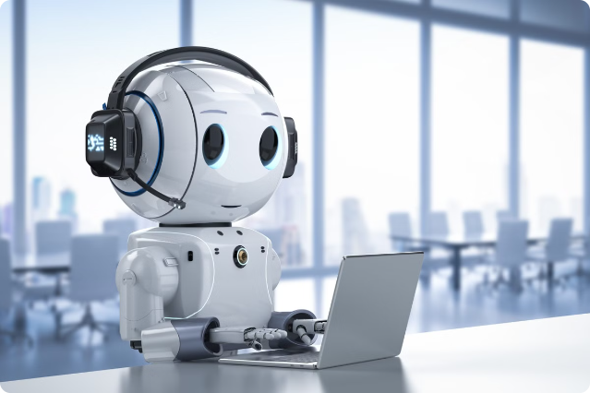
EunoiaAI
AI-Powered Mental Health Support Chatbot
Our chatbot offers real-time emotional support, personalized coping strategies, and resources to help users navigate mental health challenges.
​
by CODE CATALYSTS

Slide 2

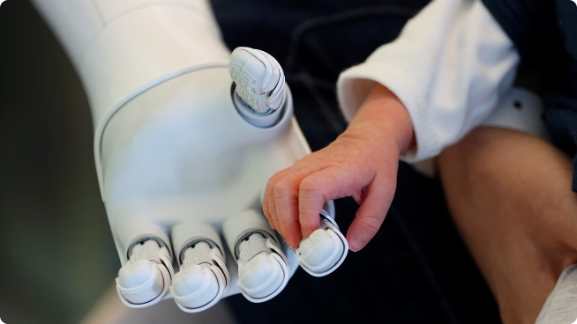




Introduction
Code Catalysts presents an innovative mental health support chatbot. Our team, comprised of Sanjana Ravishankar, Pavithra, and Sanjana Murari, aims to provide accessible and effective mental health support through this AI-powered solution.
Empathy
Accessibility
The chatbot understands and responds to users' emotions with empathy and care.
Available 24/7, providing convenient and accessible support anytime, anywhere.
Personalized
Evidence-Based
Tailored support and resources based on individual needs and preferences.
The chatbot leverages research-backed coping strategies and resources.

Slide 3


Problem Statement
Mental health issues are prevalent, impacting individuals' well-being and daily lives. Existing mental health services often face limitations such as accessibility, cost, and stigma. The chatbot addresses these gaps by providing affordable, convenient, and confidential support.
1
Accessibility
2
Confidentiality
Eliminates geographical and financial barriers to mental health support.
Offers a safe and anonymous space for users to express themselves freely.
3
Availability
Provides instant support, anytime and anywhere, breaking down the stigma of seeking help.

Slide 4
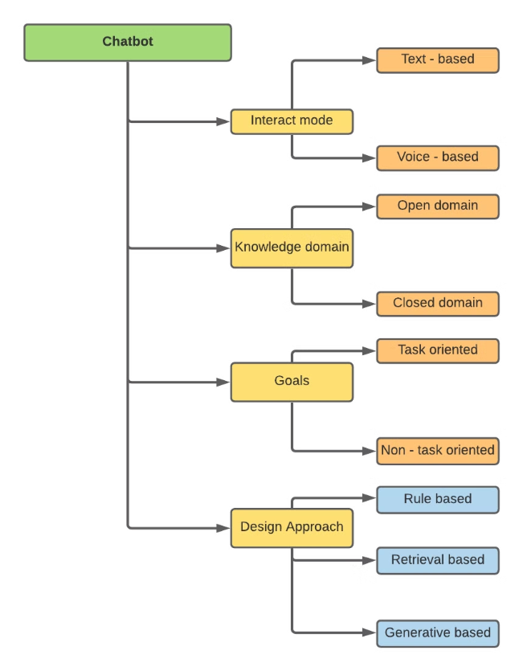
Key Features of the Chatbot
Our chatbot is designed with a user-centric approach, offering comprehensive features to enhance mental well-being.
Real-Time Emotional Support
Personalized Coping Strategies
Provides immediate comfort and validation, offering a listening ear and understanding in times of need.
Leverages NLP to understand individual needs and recommends tailored coping mechanisms.
Resource Sharing
Motivational Feedback
Provides access to relevant mental health resources, including helplines, support groups, and self-care tools.
Offers encouragement and positive reinforcement to promote resilience and self-efficacy.

Slide 5

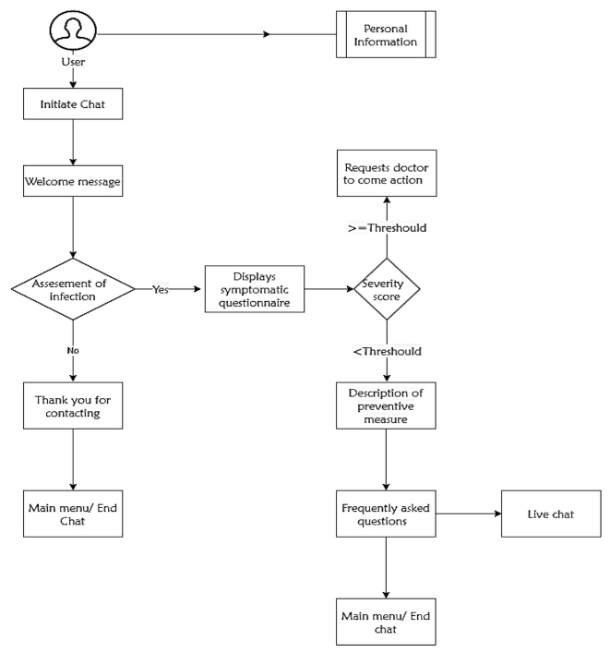
User Flow and Interaction
The chatbot's interaction process is designed to be intuitive and user-friendly.
1
Welcome Message
The chatbot greets the user and explains its purpose and features.
2
Emotion Detection
The chatbot analyzes the user's text to identify their emotional state.
3
Support and Resources
Based on the identified emotion, the chatbot offers relevant support and resources.
4
Feedback and Evaluation
The chatbot collects user feedback to continuously improve its performance.

Slide 6

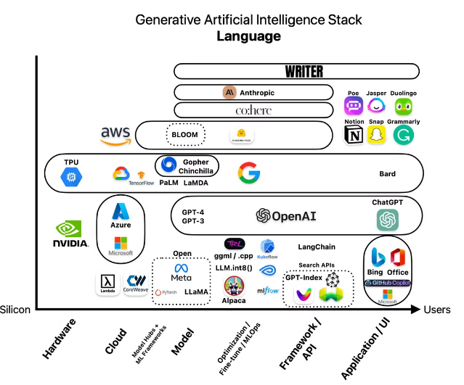
Underlying Technology Stack
The chatbot is built upon a robust technology stack, leveraging advanced NLP and AI tools.
NLP Tools
NLTK, spaCy, GPT-3
Emotion Analysis
BERT, RoBERTa, Emojify
Backend and Database
Python, Django,MySQL
Frontend Interface
React, HTML, CSS

Slide 7

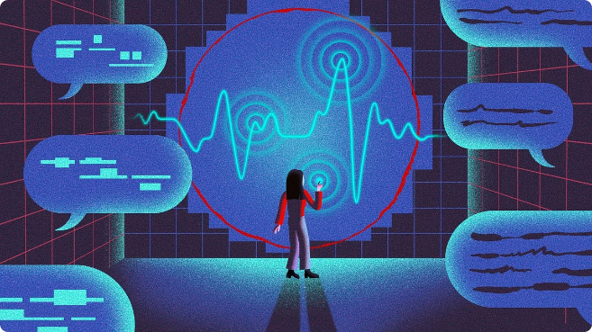



Development and Training Process
The chatbot's development and training process involves meticulous data collection, model training, and testing.
Data Collection
Data is gathered from various sources, including online mental health forums, user interactions, and research studies.
Model Training
The NLP model is trained using the collected data, focusing on language understanding, emotion recognition, and response generation.
Testing
The chatbot is rigorously tested to evaluate its accuracy, effectiveness, and user experience.

Slide 8

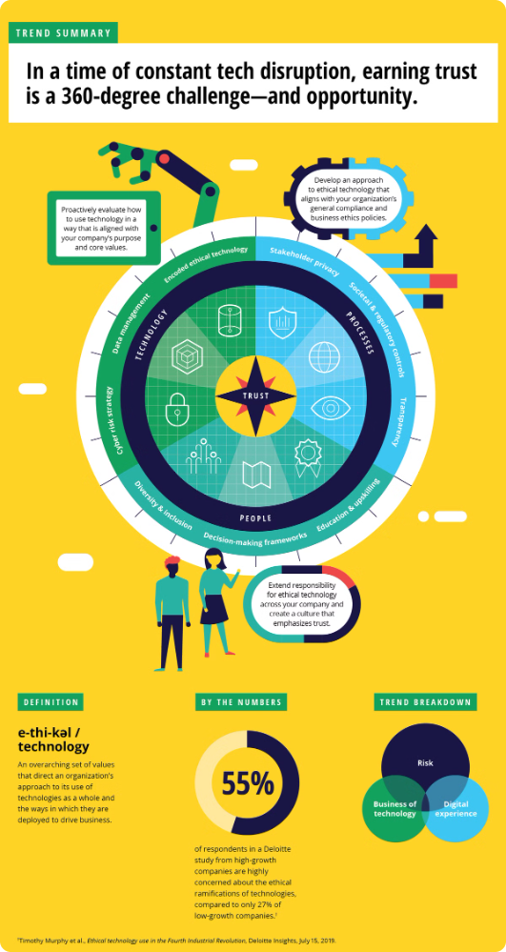
Ethical Considerations
Ethical considerations are paramount in the development and deployment of the chatbot.
1
Privacy
2
Transparency
User data is protected through secure storage and encryption methods.
Users are informed about the chatbot's capabilities and limitations.
3
Responsible AI
The chatbot is designed to be unbiased, respectful, and avoid perpetuating harmful stereotypes.

Slide 9

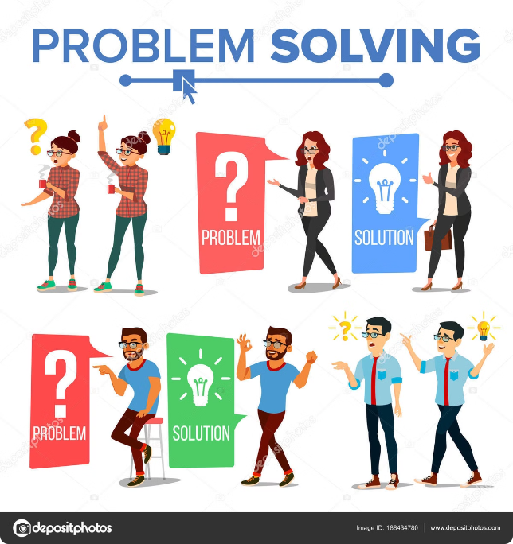
Challenges and Solutions
The development and deployment of a mental health chatbot presents unique challenges, requiring innovative solutions.
Potential Challenges
Solutions
Emotional Accuracy
Continuous model training and improvement using user feedback.
User Privacy
Strict adherence to data privacy regulations and ethical guidelines.
Bias Mitigation
Diverse training data and regular bias audits to ensure fairness and inclusivity.

Slide 10
CONCLUSTION
The AI-powered mental health support chatbot offers real-time emotional support, personalized coping strategies, and valuable resources using NLP and emotion recognition technologies. It enhances user experience with motivational feedback and self-care reminders, promoting mental well-being. Ethical considerations like user privacy and crisis management are prioritized. Despite challenges, proposed solutions aim to ensure effectiveness. This innovative approach has the potential to provide accessible, immediate mental health assistance, positively impacting overall well-being.
LINK:https://github.com/Sanjuravishankar/AI-Powered-Mental-Health-Support-Chatbot.git

